Slide 1

TITLE
Subtitle
Your Home Solutions Partner
Date

Slide 2
Who We are
Perfect Square is a an integrated Residential development solutions company based in Kenya. We pride ourselves in bringing the best of quality, Trust and superlative customer focus into the construction, Solar power and water solutions sector in Kenya. We draw from several years of individual and collective experience and extensive exposure to cutting edge solutions in Green energy, Construction and Water provision. Our core business areas are Solar Power provision, Water Drilling, development and supply and Housing construction.

Slide 3
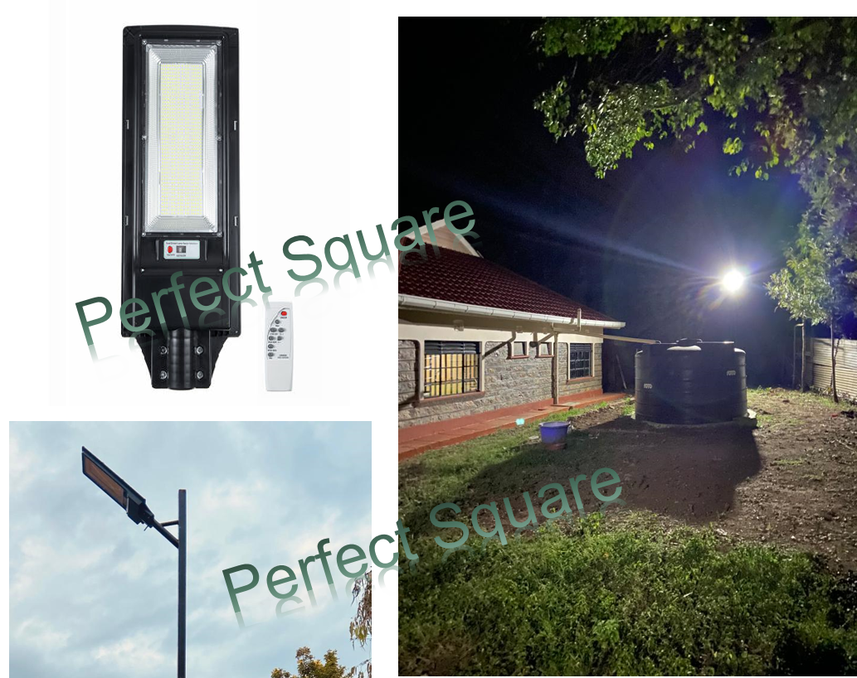
3600W 966LED Dusk to Dawn Lamp
What We do: Solar Security Lights
Product details
Features
Installation
Wall or Mast mounted
Attributes
Movement detector
Description
Features: - Solar charging, - Easy installation, without wires. - 966LED, high-brightness LED lamp beads, green and energy saving. - High quality batteries, long service life, large capacity. - Aluminum alloy body, prevent bask in rain. - strong infrared remote control receiving. - IP65 waterproof. - 8m distance wireless remote control. - Polycrystalline Solar Panel convert solar energy into electricity, - Human body sensing technology makes it more energy-efficient, light on when sensing motion, dim light when sension no motion.

Slide 4
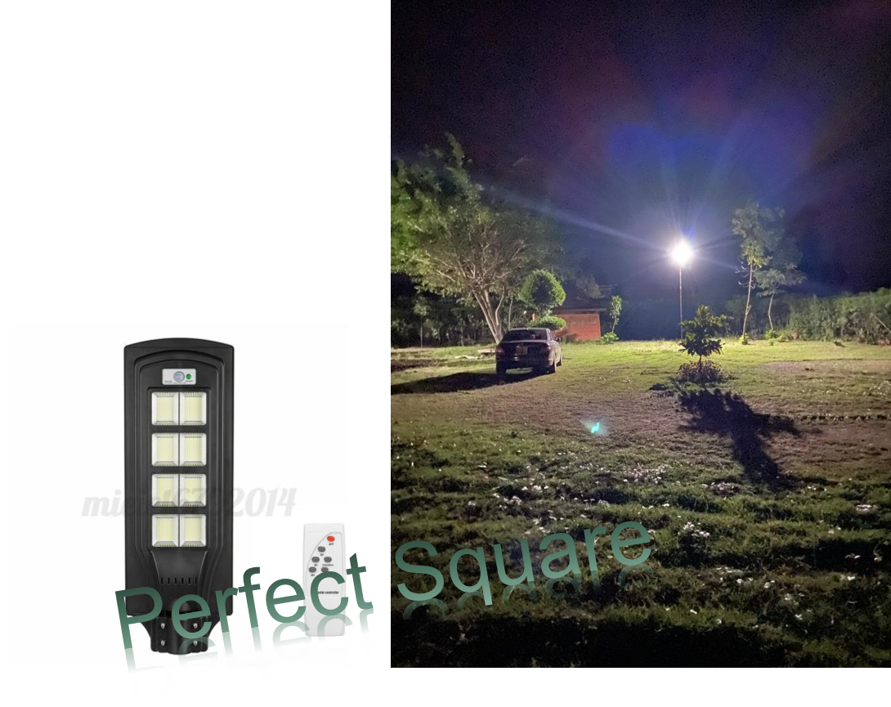
2500W 832 LED Dusk to Dawn Lamp
Solar Security Lights
Power:2500W Luminous Flux: 120000LM LED QTY:832 LED Solar Panel: 6V / 15W Polycrystalline Solar Panel Battery Capacity: 3.2V / 18AH Li iron phosphate battery Remote Controller Battery Type: 2x AAA Batteries(Not Included) Mode: Button Control + Light Control +Timing Control + Remote Control Light Color: White Shell Color: Black Material: ABS Irradiation Area: 150 Square Meters Full Charge Illumination Time: 9-10H Discharge Time: 12-13H, light on when sensing motion, dim light when sensing no motion.

Slide 5
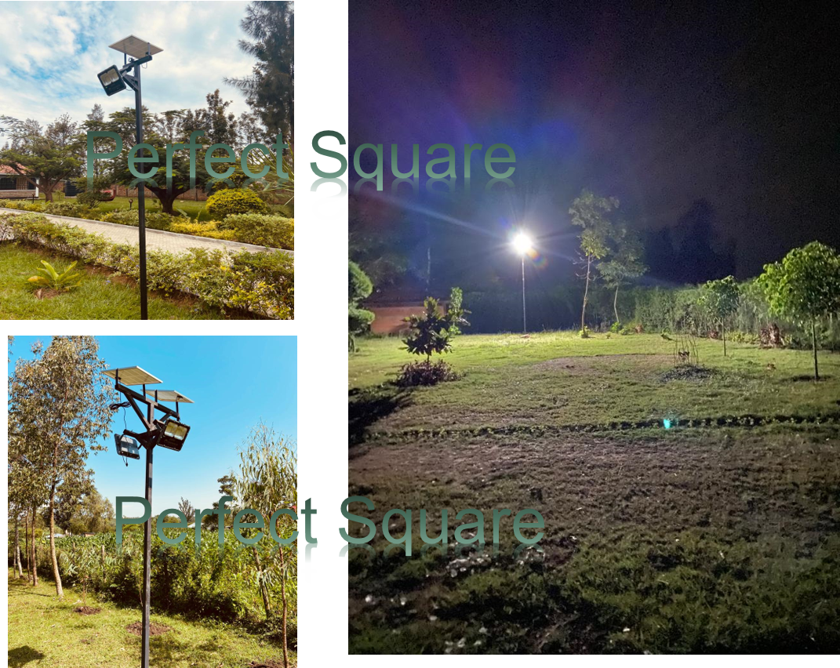
200W LED Dusk to Dawn Flood Light
Solar Security Lights
Power:200W Luminous Flux: 20000LM LED QTY:320 LED Solar Panel: 6V / 15W Polycrystalline Solar Panel Battery Capacity: 3.2V / 18AH Li iron phosphate battery Remote Controller Battery Type: 2x AAA Batteries(Included) Mode: Button Control + Light Control +Timing Control + Remote Control Light Color: White Shell Color: Black Material: ABS Irradiation Area: 80 Square Meters Full Charge Illumination Time: 12H

Slide 6
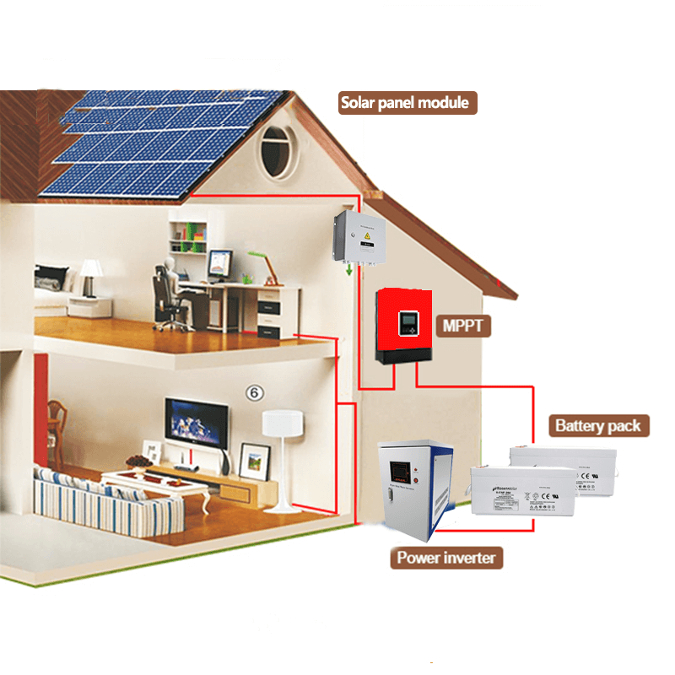
Solar Home Power Solutions
Power your home using renewable energy from the sun.

Slide 7
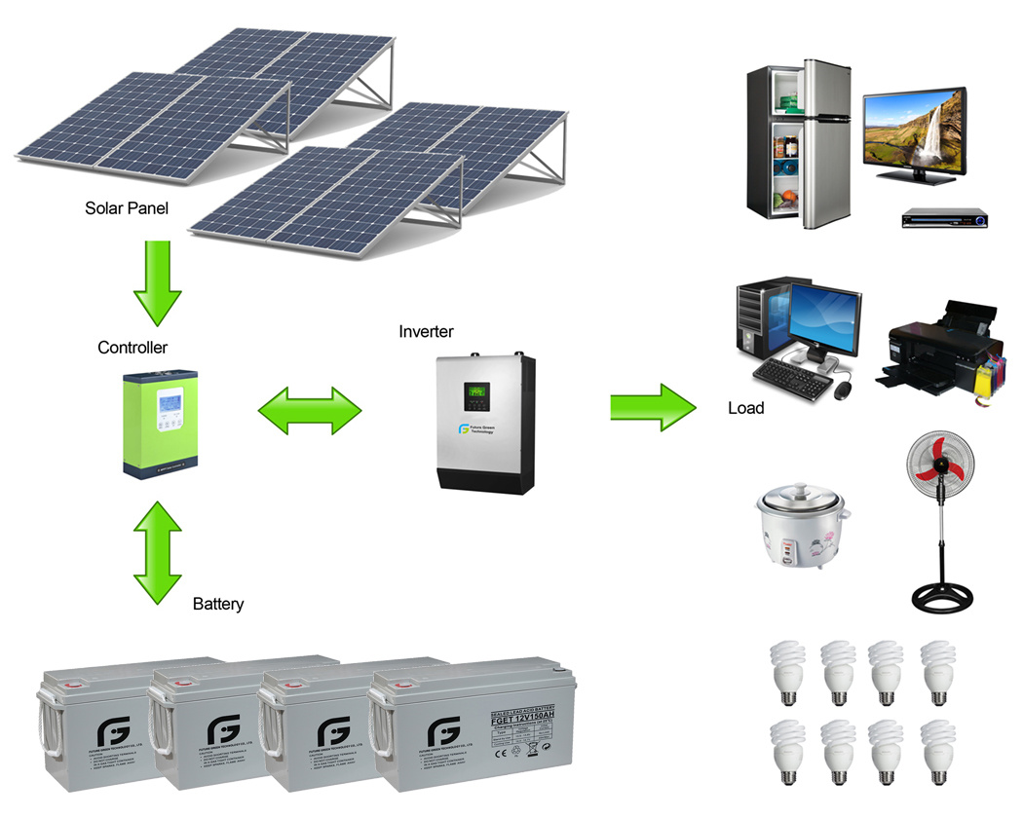
Why Solar Home Power Solutions
The most commonly known fact about solar energy is that it represents a clean, green source of energy. Solar power is a great way to reduce your carbon footprint hence save our beloved plannet.
It makes you independent of the erratic and unreliable electricity grid
Solar is durable, reliable and produces consistent clean power. No risks of spikes and outages
Its absolutely Free!

Slide 8
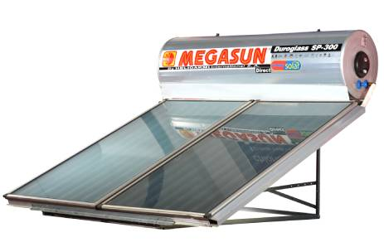
MEGASUN SOLAR 300LTR DIRECT
Solar Water Heaters
Pressurized ; Galvanized steel
300 litre tank capacity

Slide 9
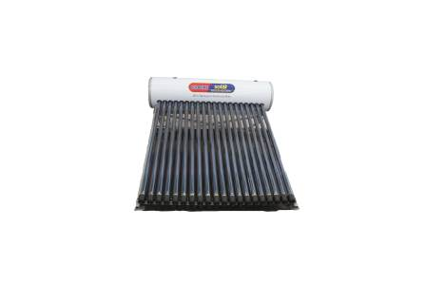
VEVTT SOLAR 200LTRs

Slide 10

Water Solutions

Slide 11
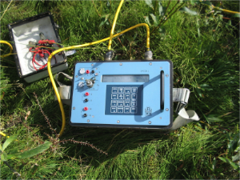
Bore Hole Drilling
GROUNDWATER is the water beneath Earth's surface in soil pore spaces and in the fractures of the rock formations. About 1 .7% of all of Earth's water and 30.1% of freshwater on the Earth occurs as ground water. Though the ground water resources are widely distributed, Nature does not provide ground water at the places of our choice.
The occurrence and distribution of ground water resources are confined to certain geological formations and structures.
The ground water at all locations may not be directly used if the quality of water is poor.
All these problems can be solved using proper exploration techniques.
At Perfect Square we use Electrical Resistivity Tomography (ERT)
This first step allows us to ascertain not only the presence of a good saturated zone but also the type of rock formation and their ability to withstand the drilling and development process

Slide 12
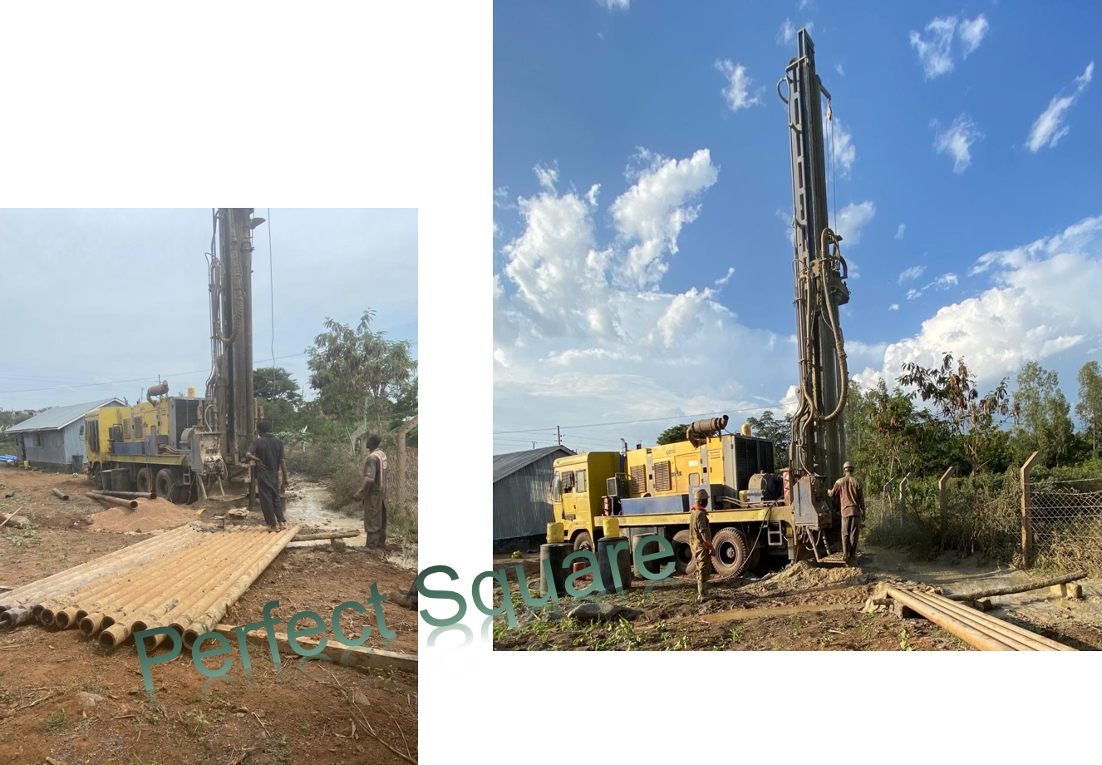
Bore Hole Drilling
The Geophysical Survey report therefore guides the spot and depth to drill and also the type of equipment to install.
After drilling and casing, there is a detailed water testing done by the Government Chemist followed by obtaining of all the necessary approvals and licences

Slide 13
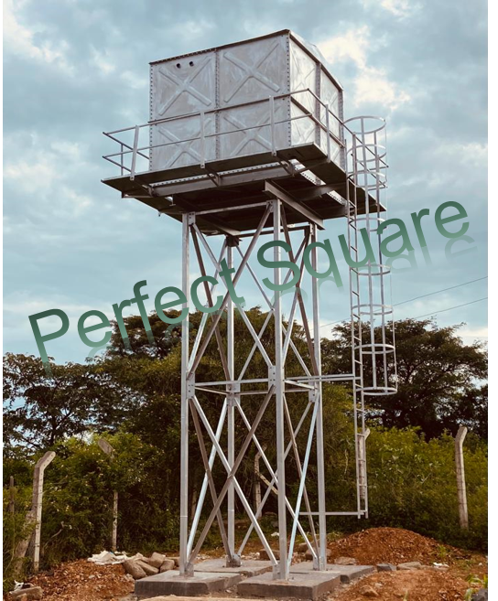
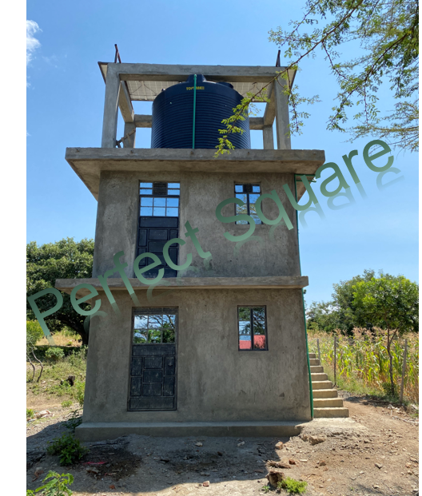

Pumping and Storage
We typically like to propose solar water pumps for our customers. Though having a high initial cost, solar pumps cost nothing to run and can go on working for years.
There are a variety of water storage solutions to choose from including steel tanks and towers, plastic tanks and even concrete towers.
At Perfect Square we offer the customer a one stop shop. Delivering from prospecting to plumbing the water into your house and/or farm

Slide 14
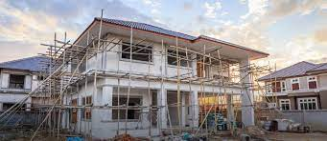
Housing Construction

Slide 15

Construction
Investing in a decent house be it on straight-up purchase or construction is by far the most significant and satisfying achievement to anyone
Building a house from scratch is even more satisfying since it gives you the freedom to apply your philosophy, ideas, dreams and preference in the colour, shape size into the home.
Unfortunately constructing a house is not only highly costly but also wrought with challenges, anxiety and sometimes disappointments
At Perfect Square we partner and walk with you in your journey to home ownership be it for holiday or commercial rental space.
The first step is to listen to your needs, wants, situation, fears and expectation. We then walk with you through the design, architecture and construction phases and finally apply finishing touches before handing over the house.
The goal is to deliver to you what you desired at the right cost and schedule. We keep all records and assist with all forms of licenses and permits from relevant authorities.

Slide 16
Gallery
Some of the completed projects

Slide 17
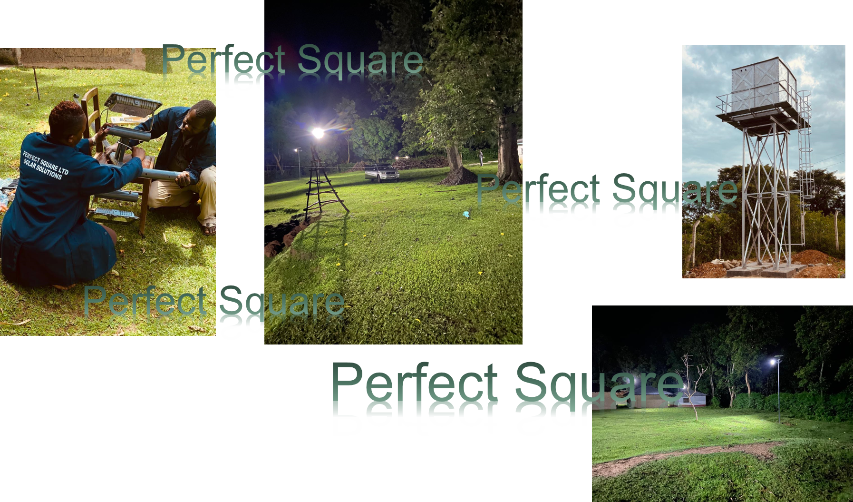
Gallery

Slide 18
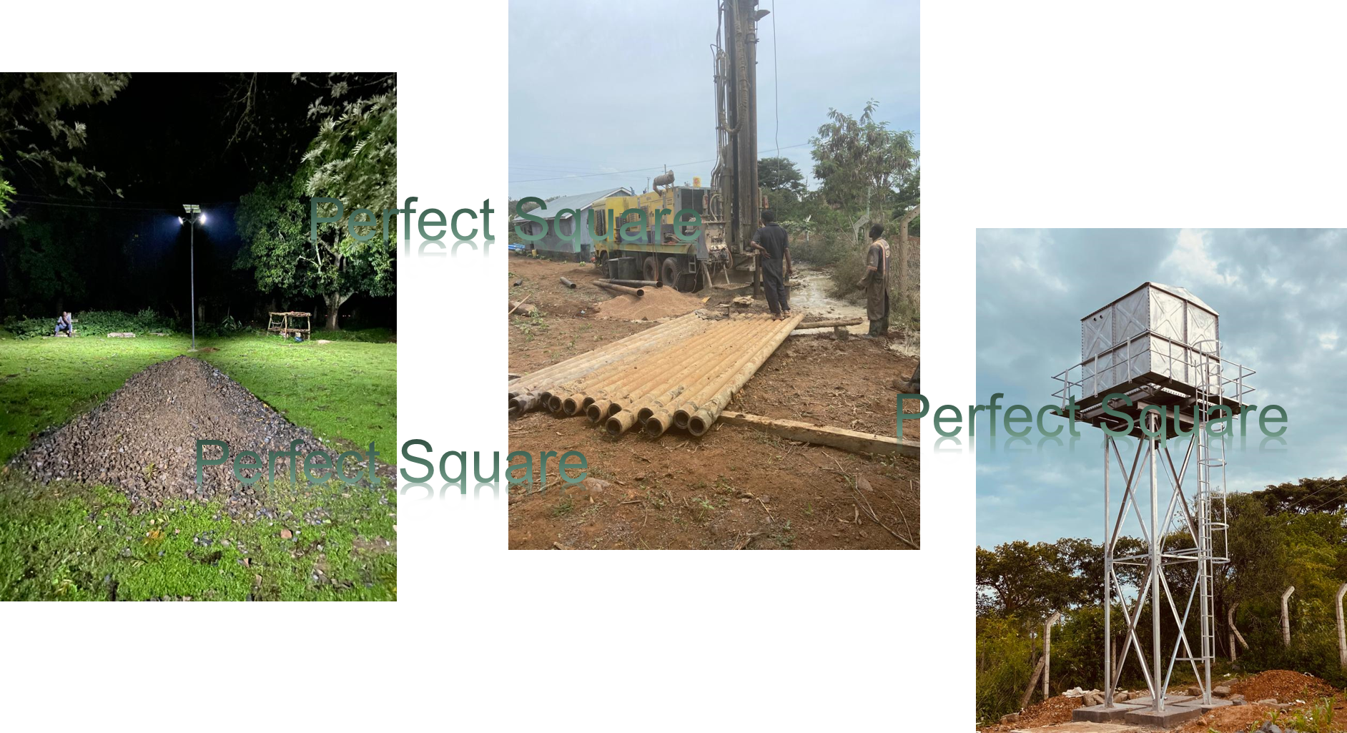
Gallery

Slide 19
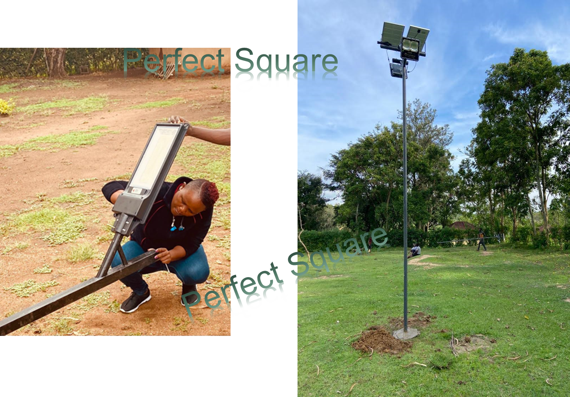
Gallery

Slide 20
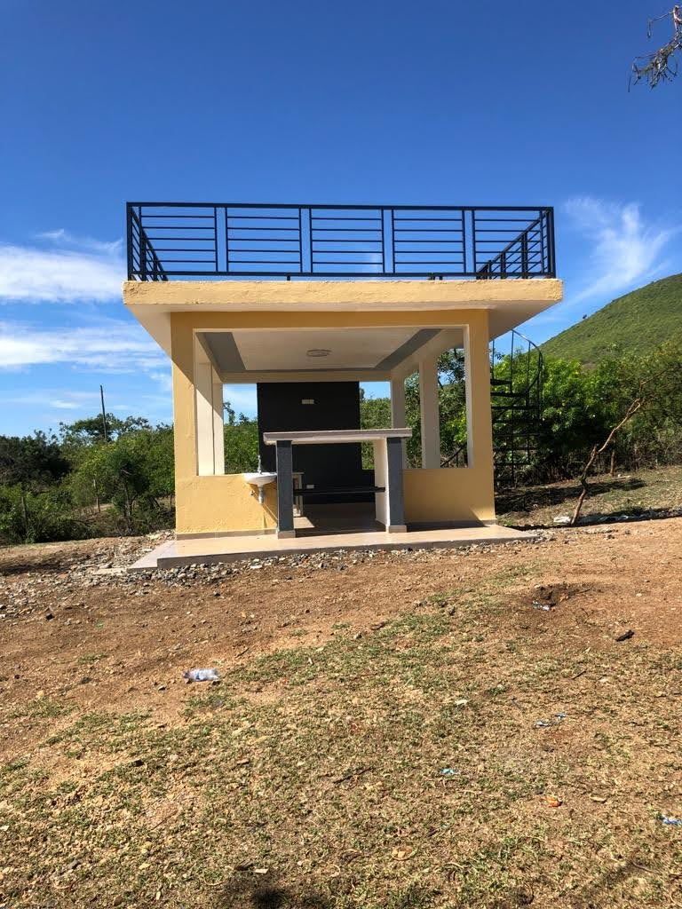
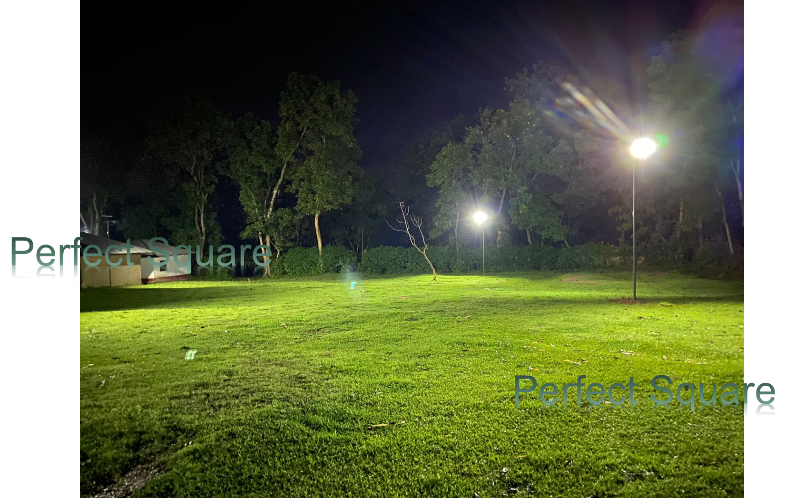
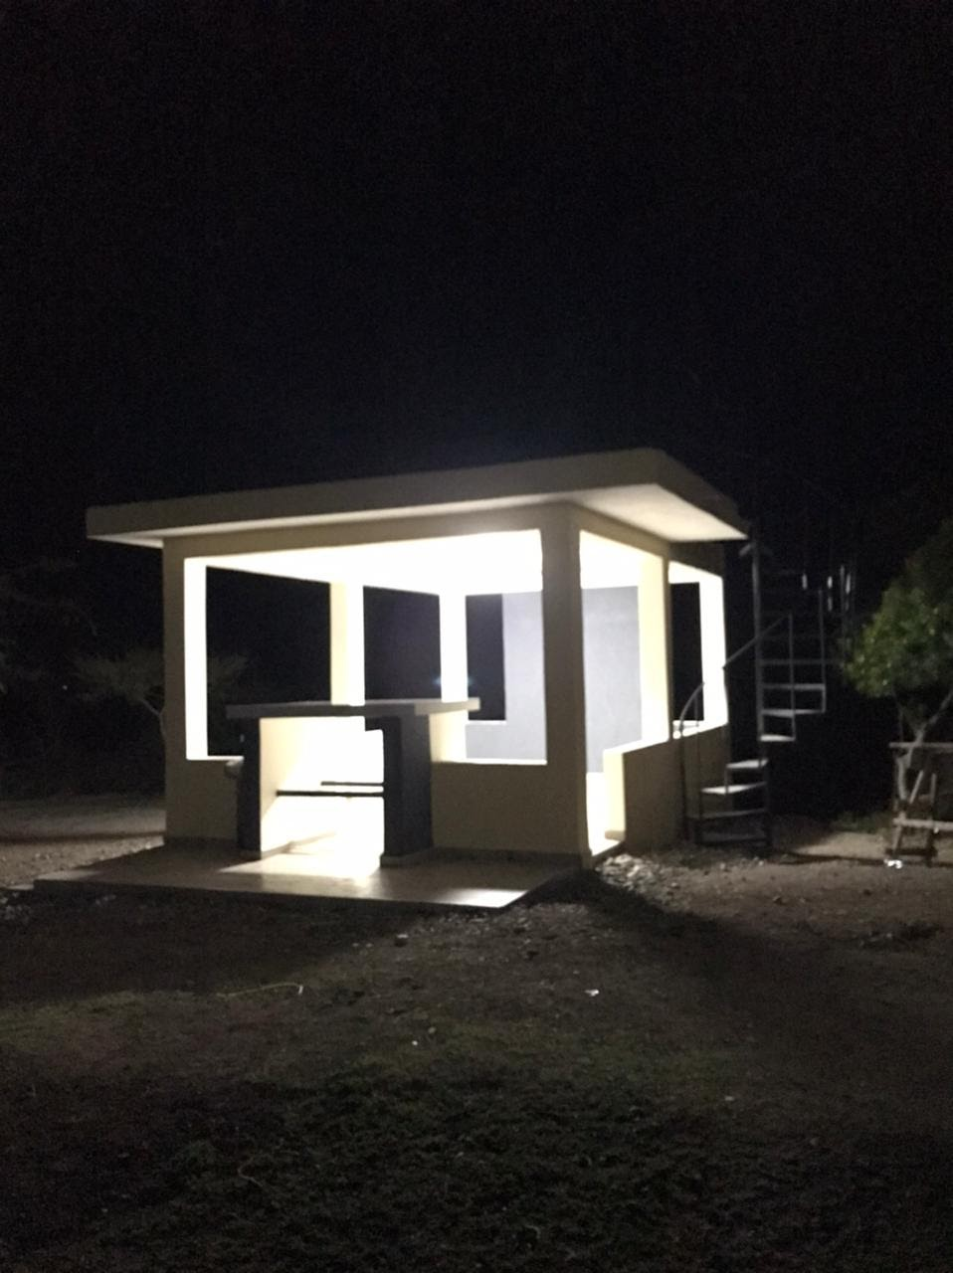
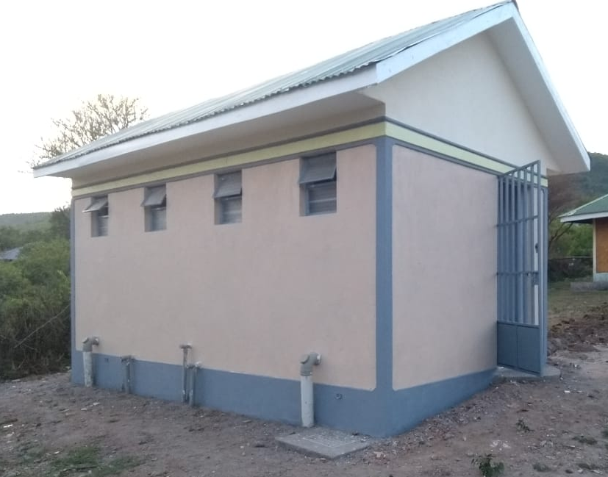
Gallery
Perfect Square
Perfect Square

Slide 21
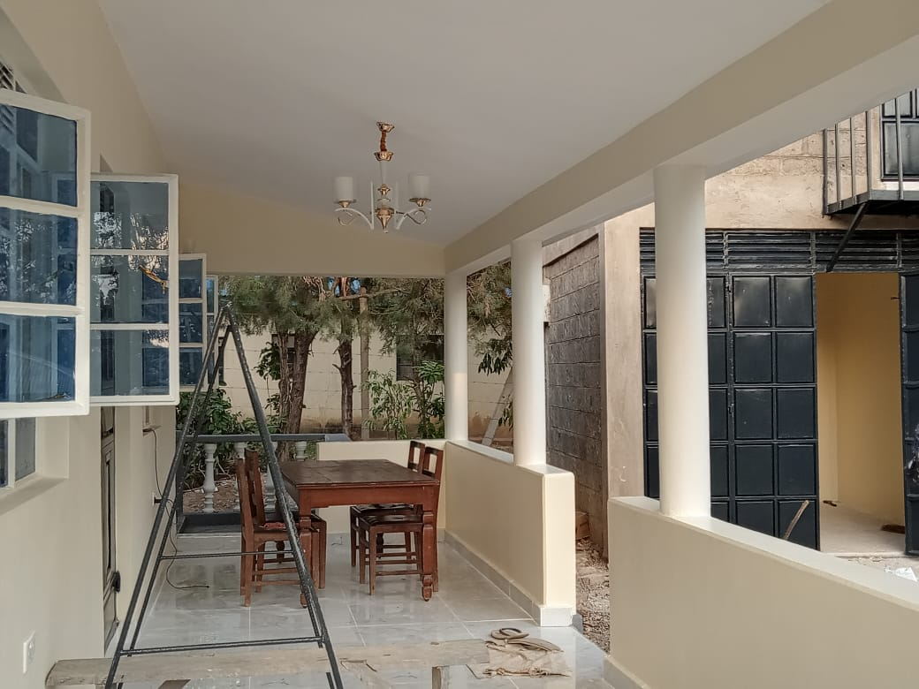
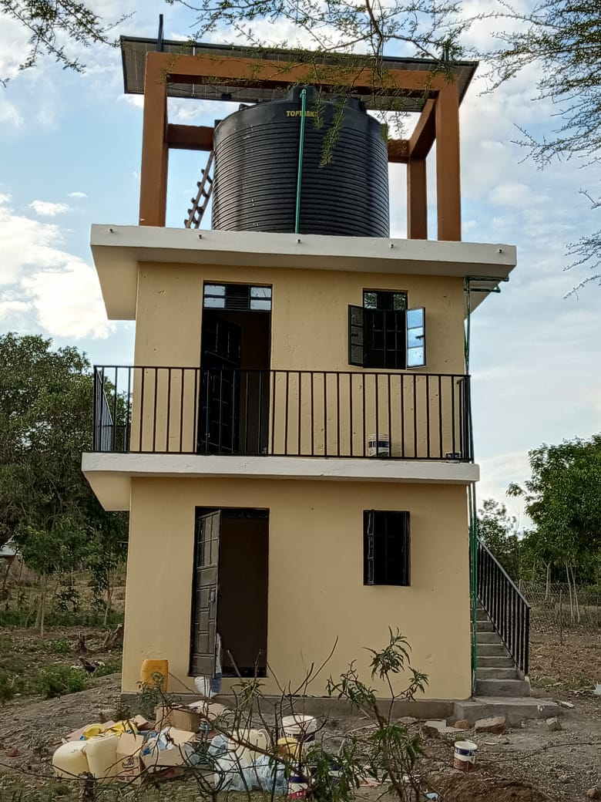
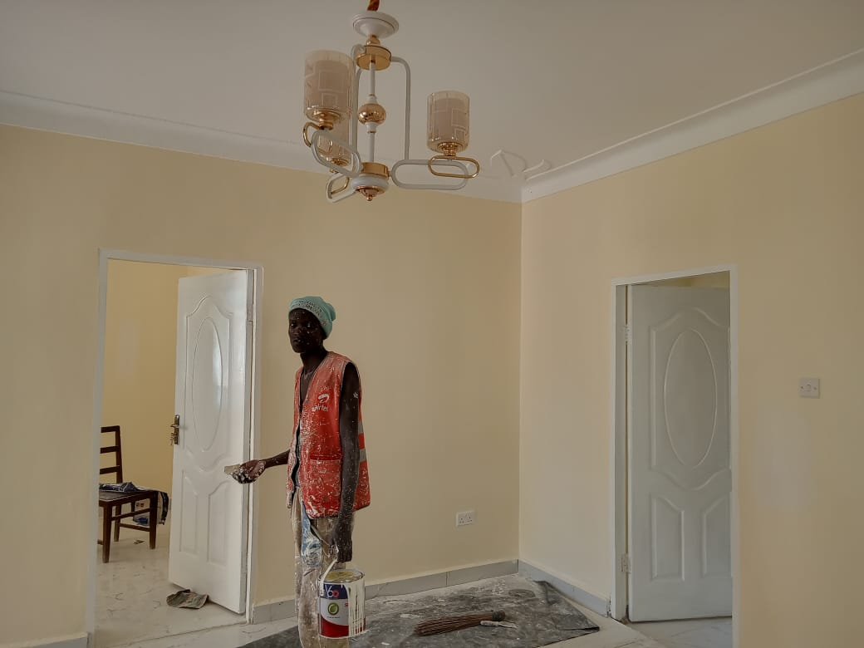
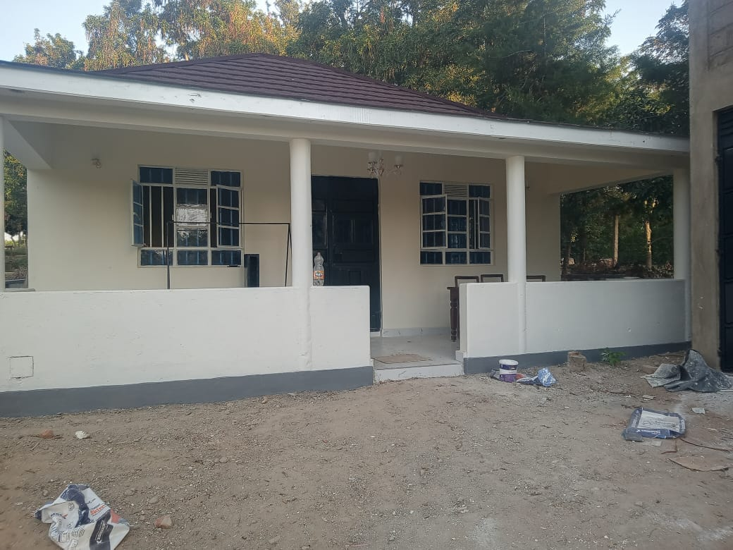
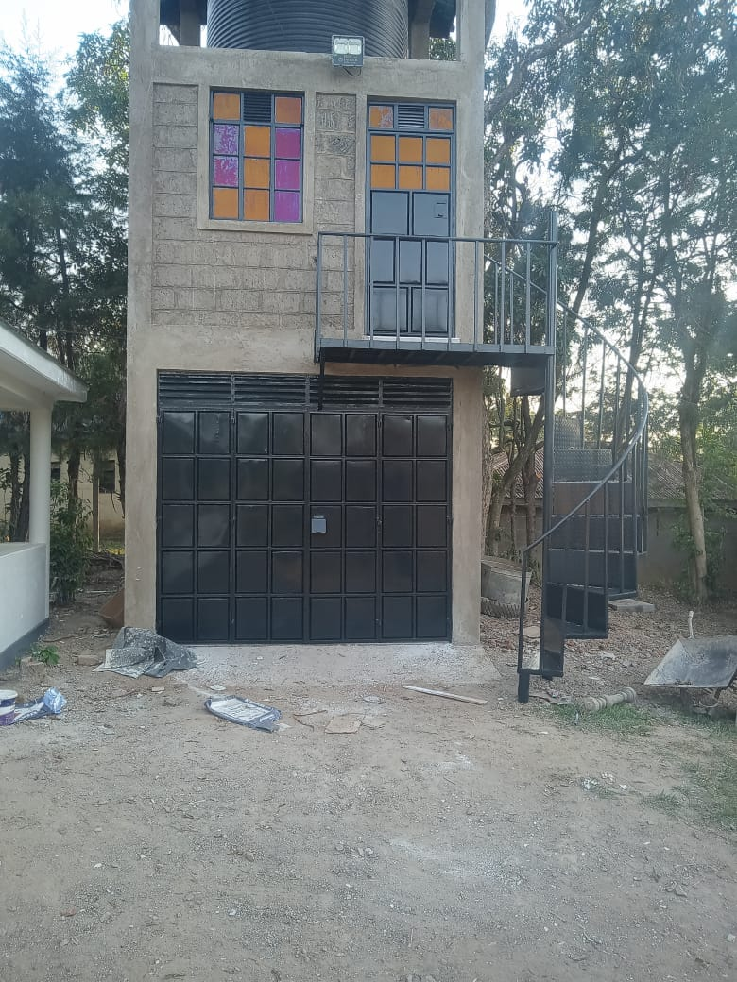
Gallery
Perfect Square
Perfect Square
Perfect Square

Slide 22
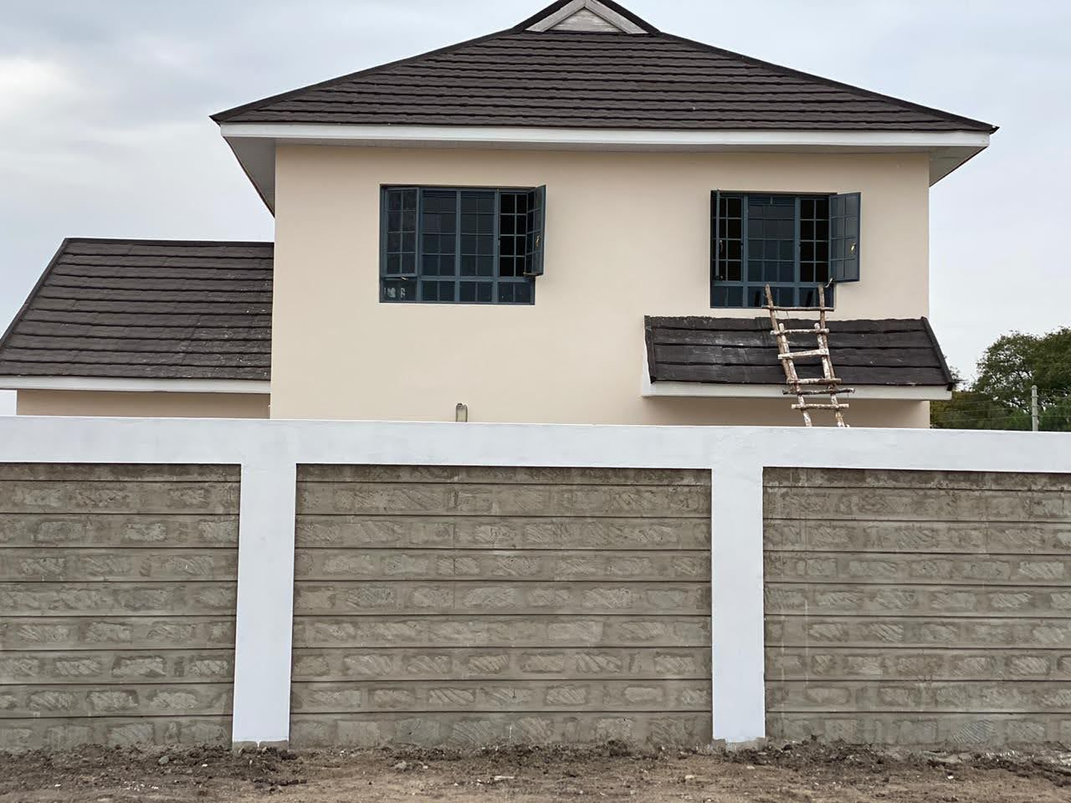
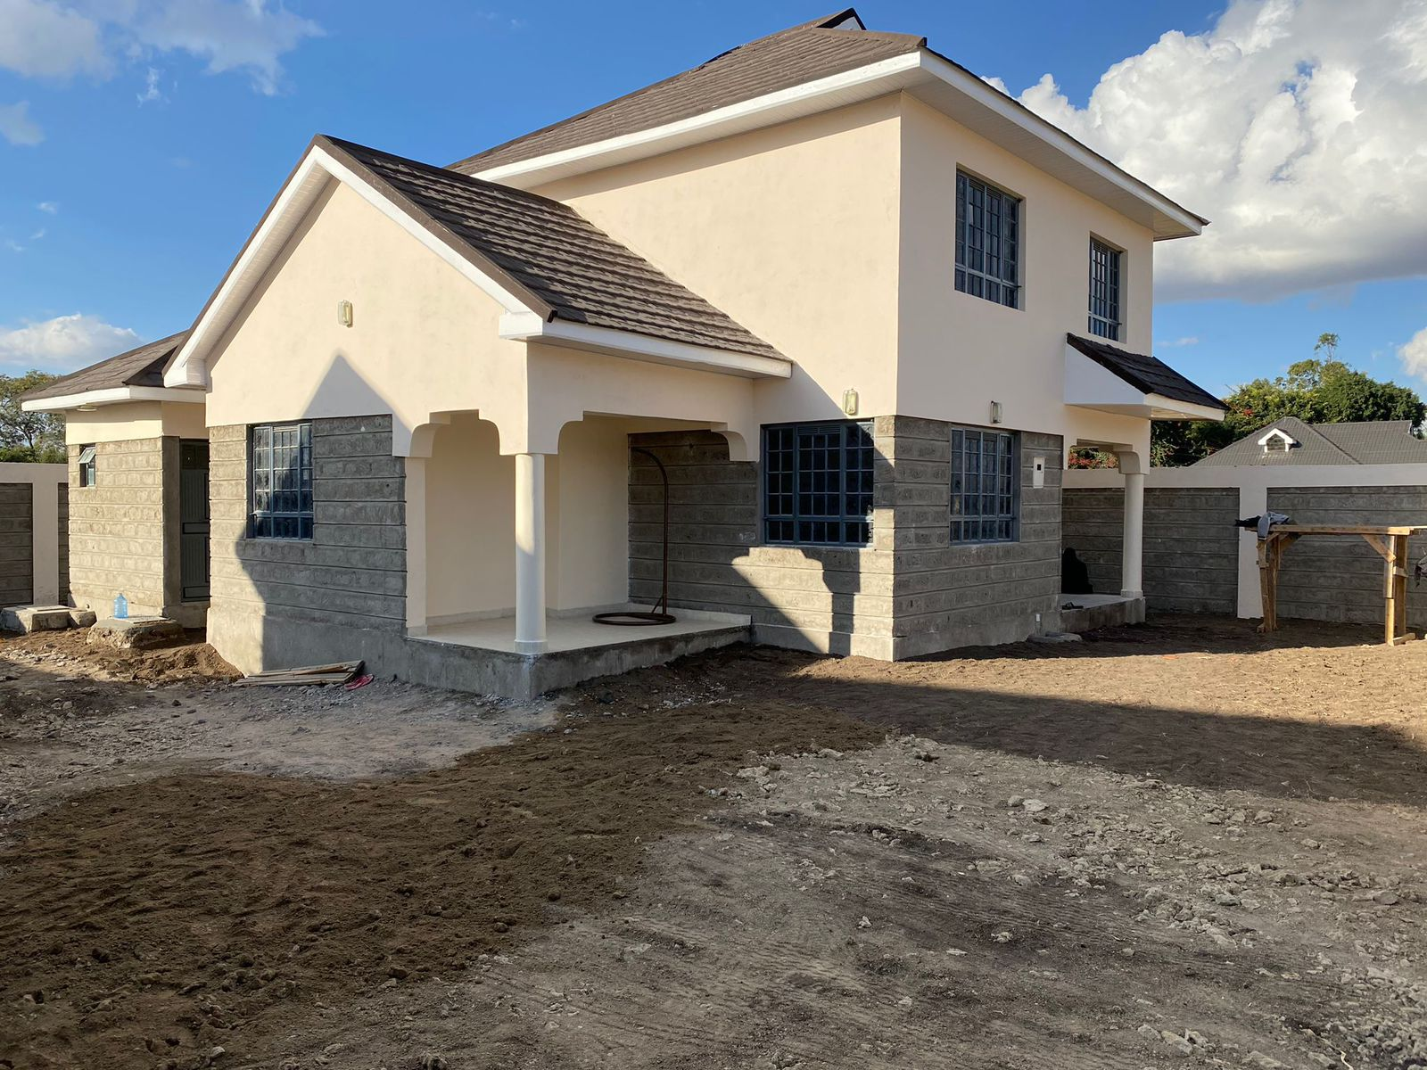
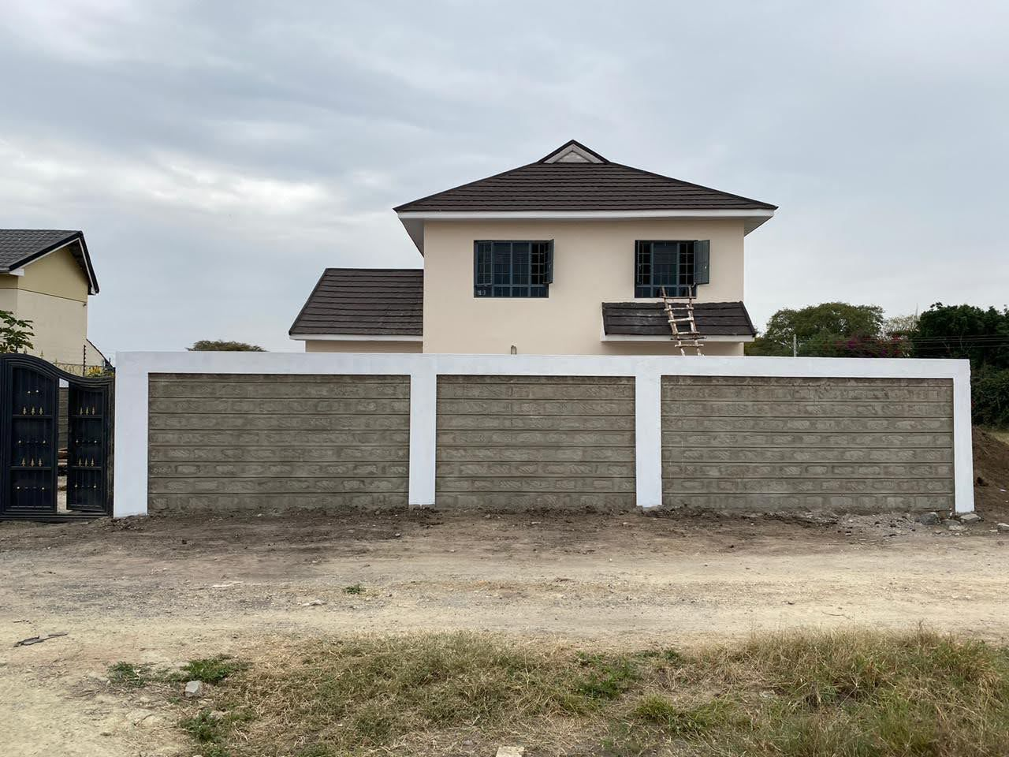
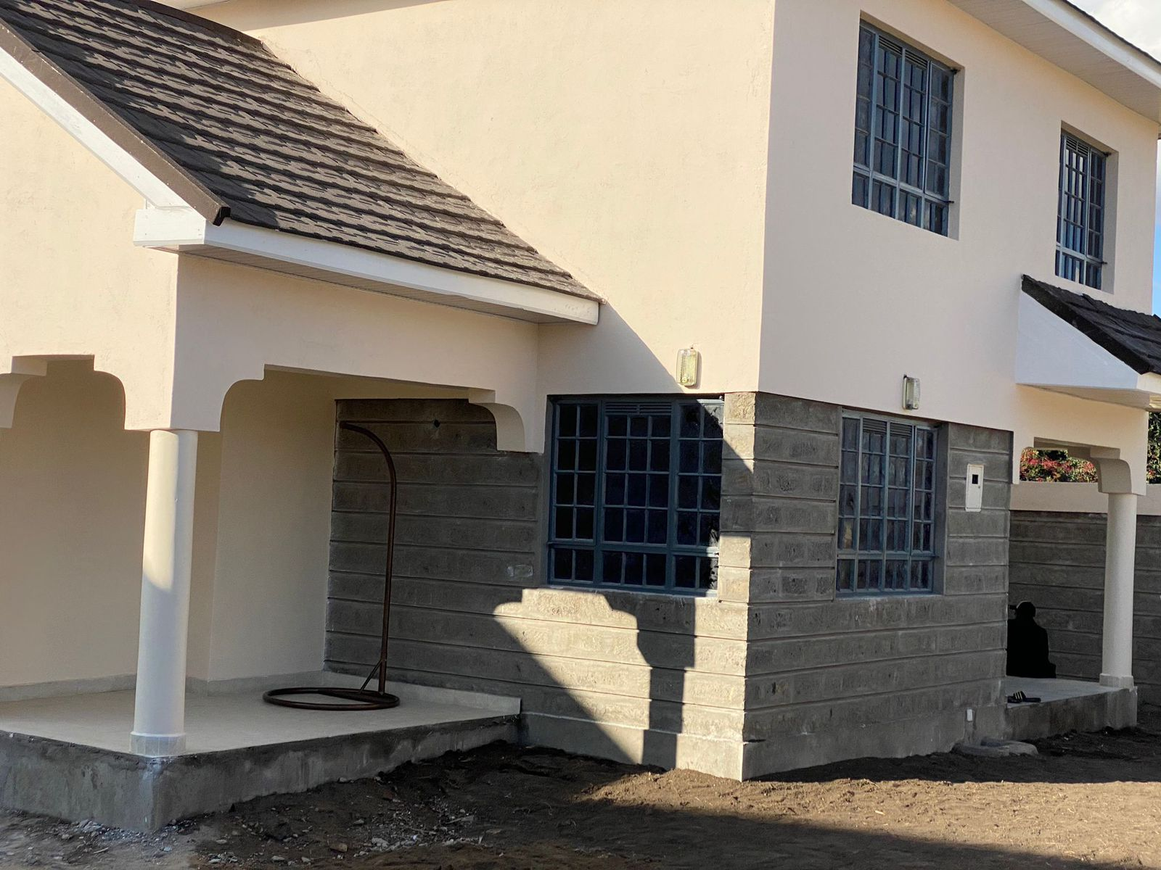
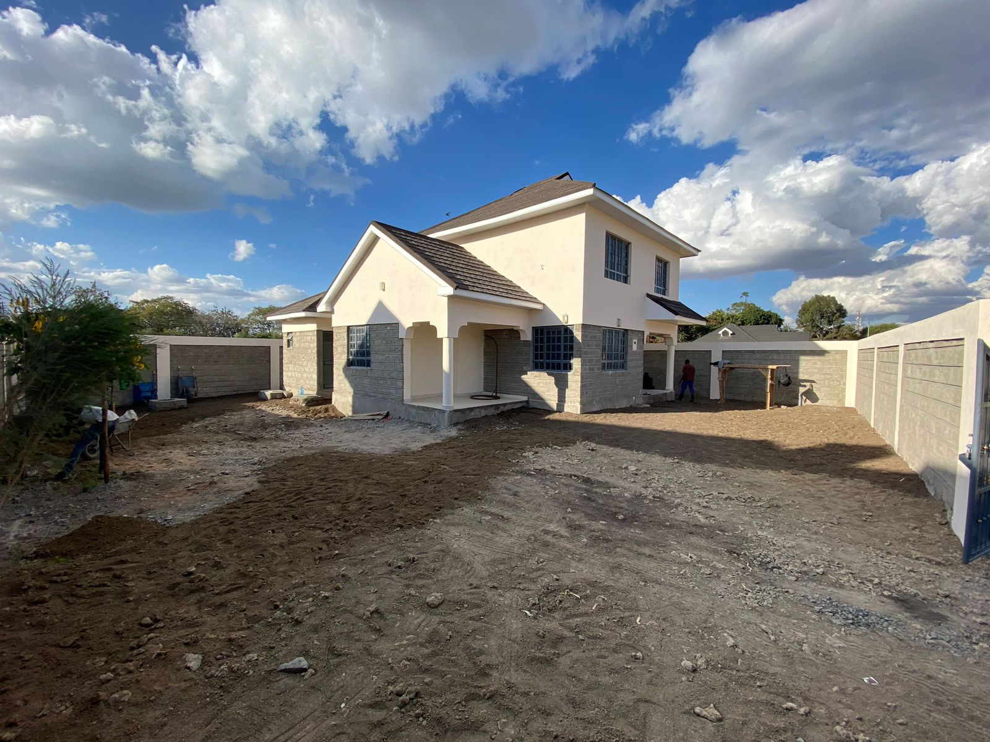
Gallery
Perfect Square
Perfect Square
Perfect Square

Slide 23
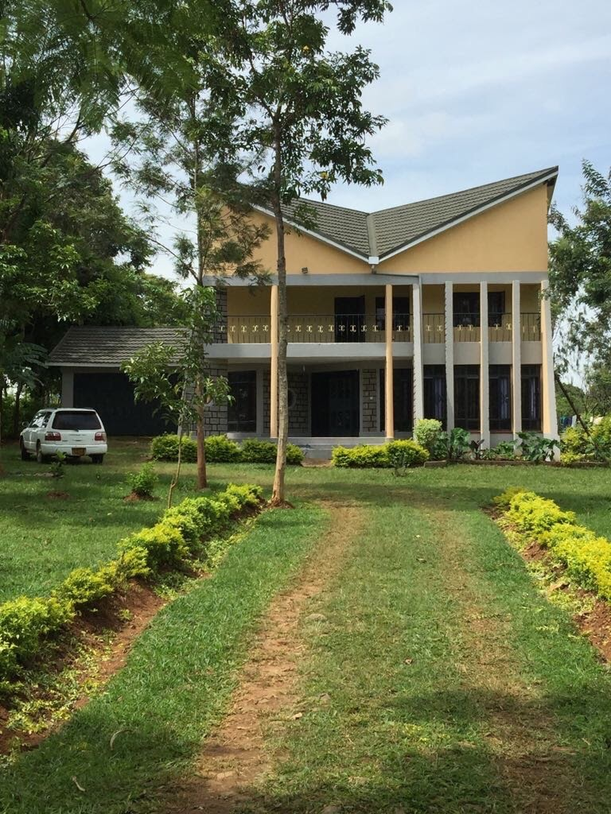
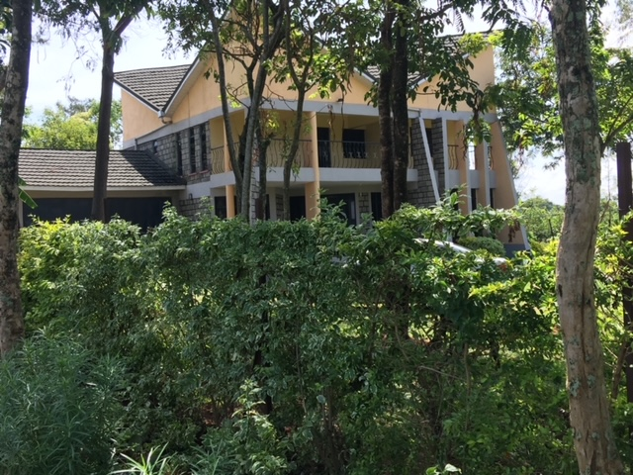
Gallery
Perfect Square
Perfect Square

Slide 24





THANK YOU!
Contact us:
Phone: +254722540649
Email: jeremiah@perfectsquare.cc

